Slide 1
Portfolio Presentation
Lexus Macalalad

Slide 2
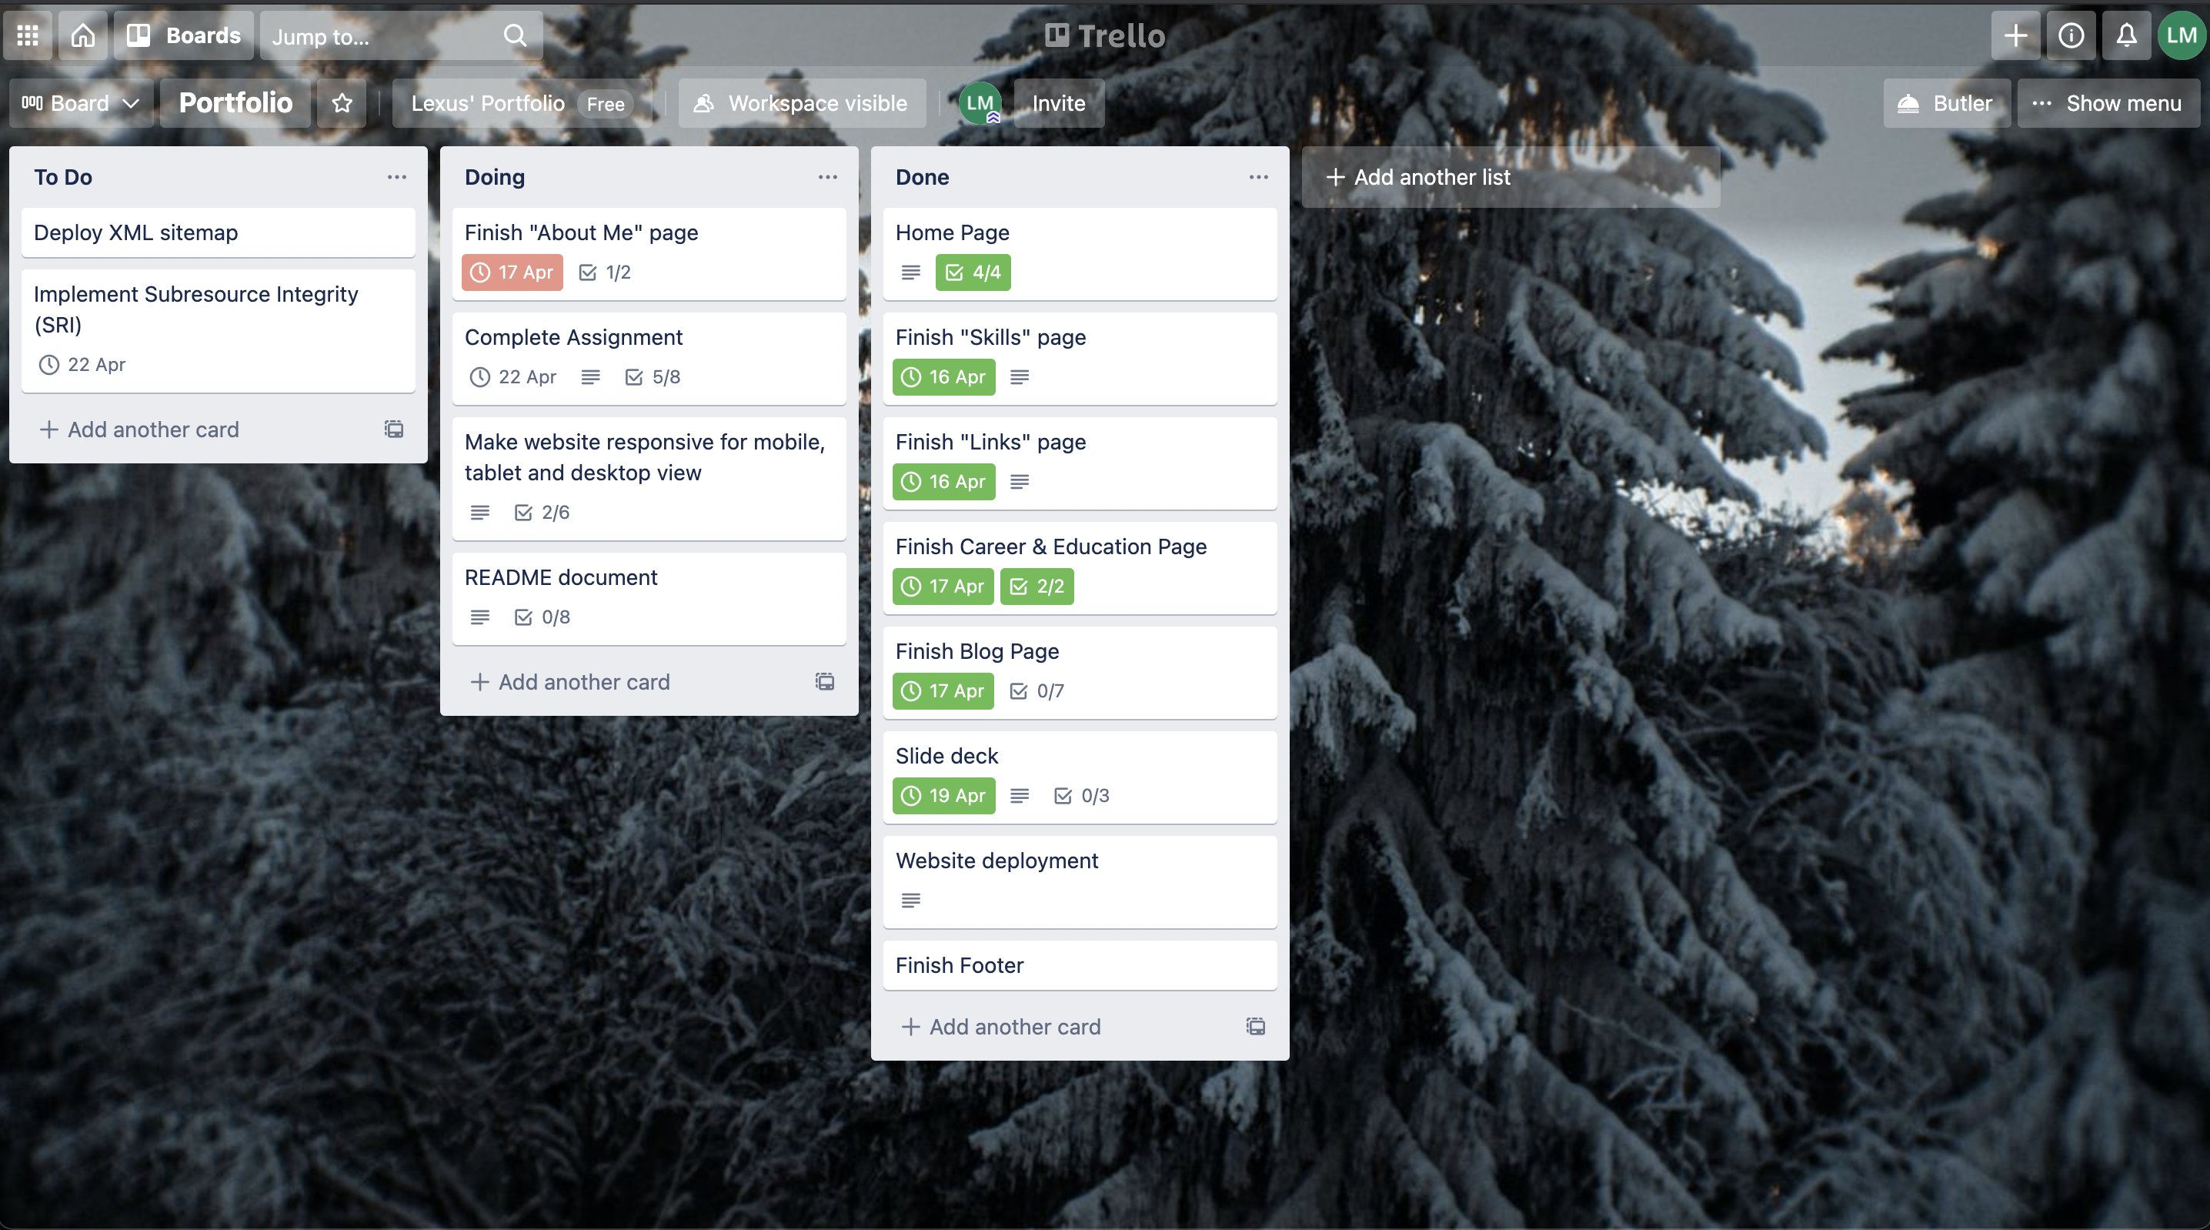
Keeping Track of Progress
Use of Trello board to keep track of progress
Hard to follow schedule as roadblocks appear

Slide 3

Design Process
Sitemaps
Colour Palette
Wireframes

Slide 4
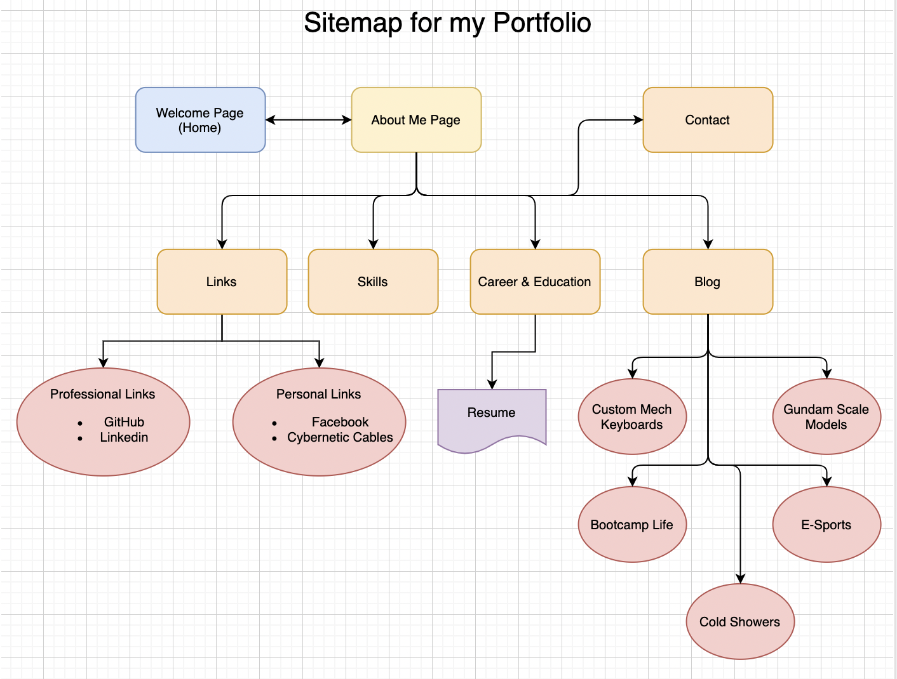
Sitemap
The goal is to have a welcome page that briefly introduces who I am
From the welcome page, About me can be accessed and the rest of the other pages can be accessed from there via navigation menu

Slide 5
Wireframes
One of the challenges was getting the website to be responsive in mobile, tablet and desktop devices.
It is important for me to mock up a design that covers all the devices
It is best to create the portfolio website as a mobile first approach, so having a design that accommodates the contents of each screen is required

Slide 6
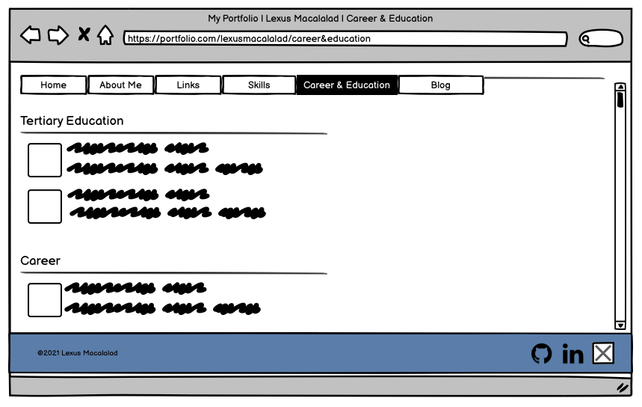
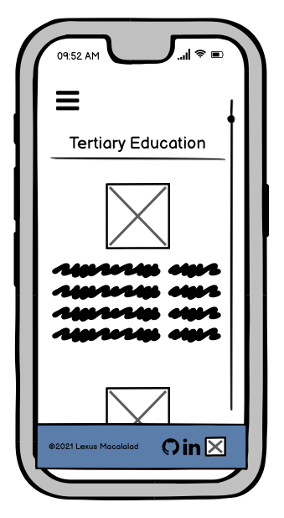
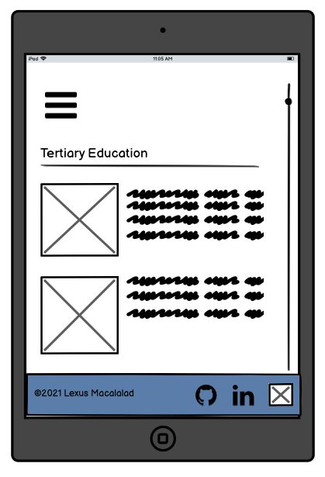
Mobile, Tablet & Desktop View
More wireframes available on the balsamiq file in the docs folder

Slide 7
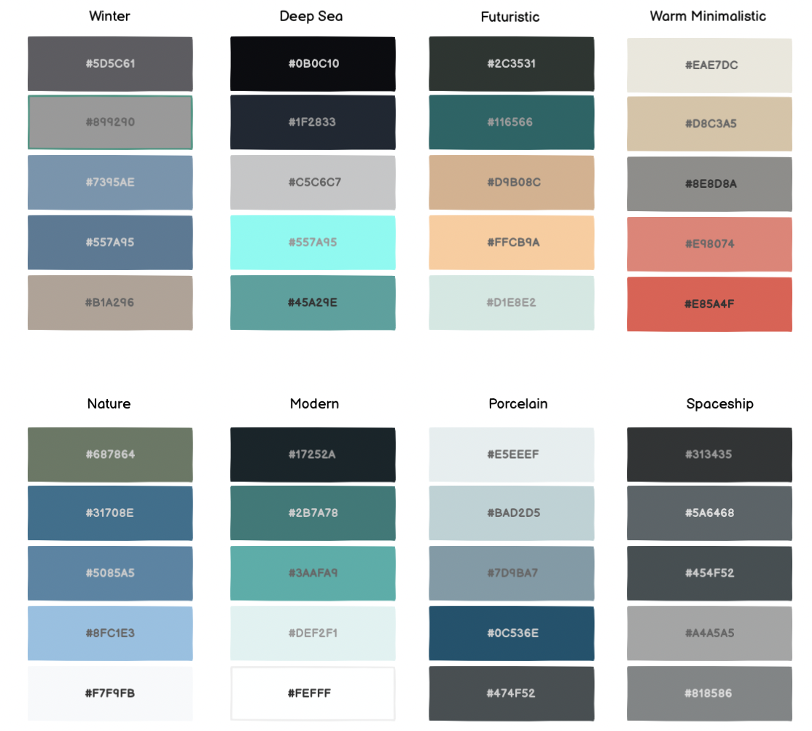
Colour Palettes
For colour inspiration for my portfolio, I searched for colour palettes that complemented each other
Initially wanted to do a dark theme
Ended up with a more minimalistic theme and chose Porcelain

Slide 8
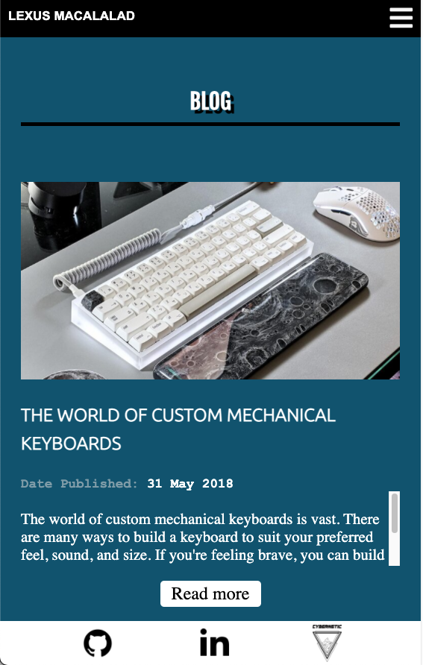
Components
Navbar allows the target audience to navigate main pages without scrolling through one single page
Footer links my important social profiles
Buttons to make the website more interactive
Hover
Transitions
Colour changes

Slide 9
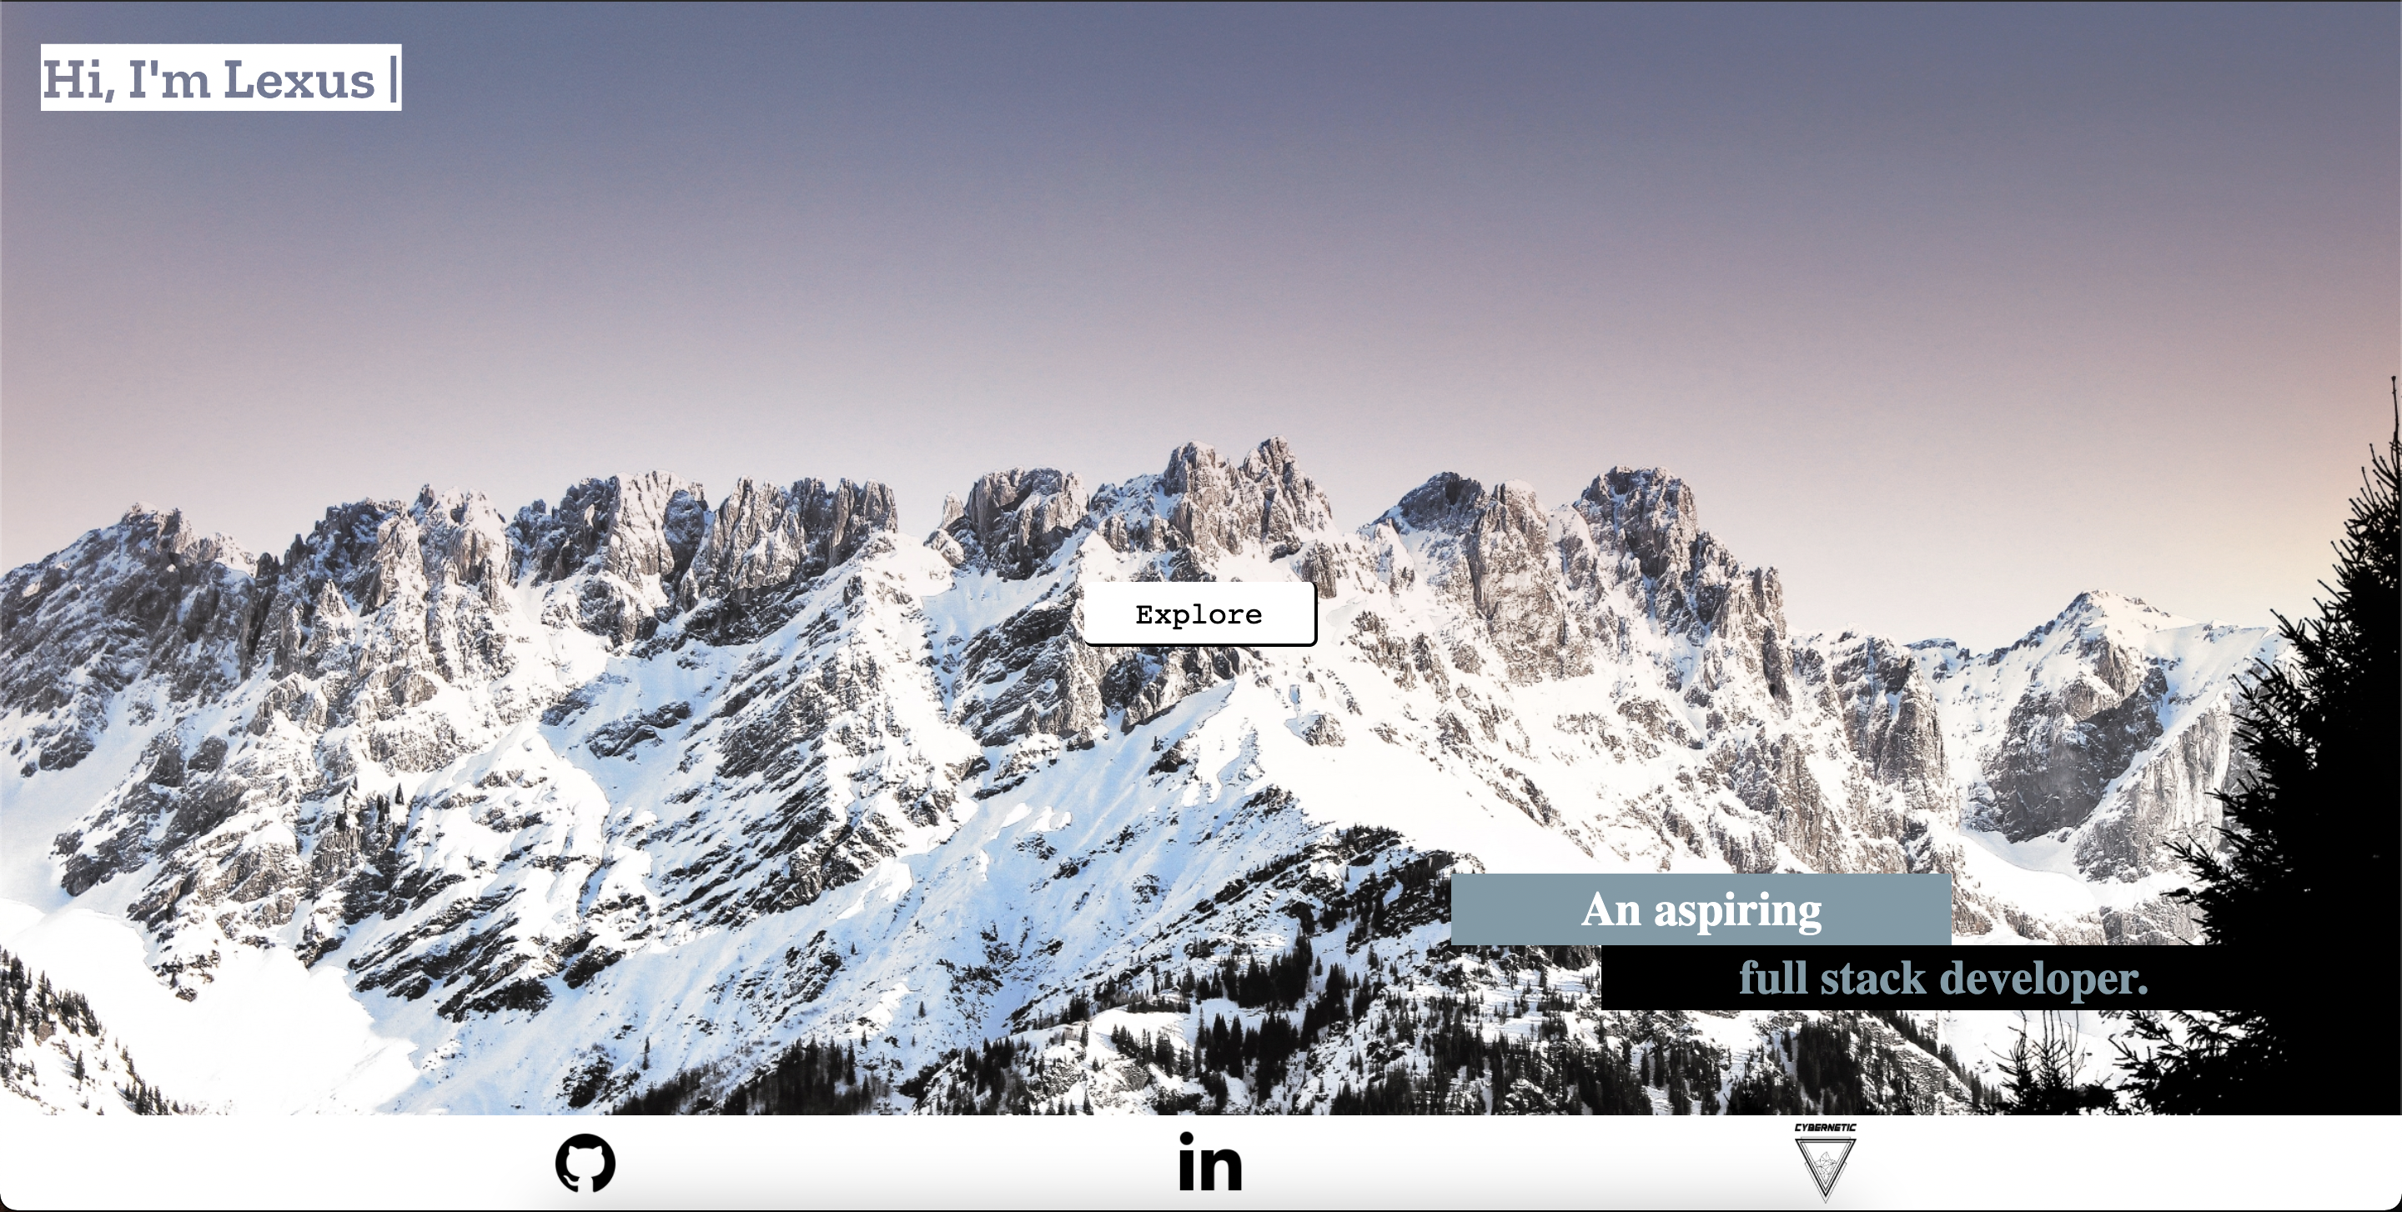
Welcome/Home Page
Gives a quick introduction of who I am, and gives the audience an invitation to learn more about me

Slide 10
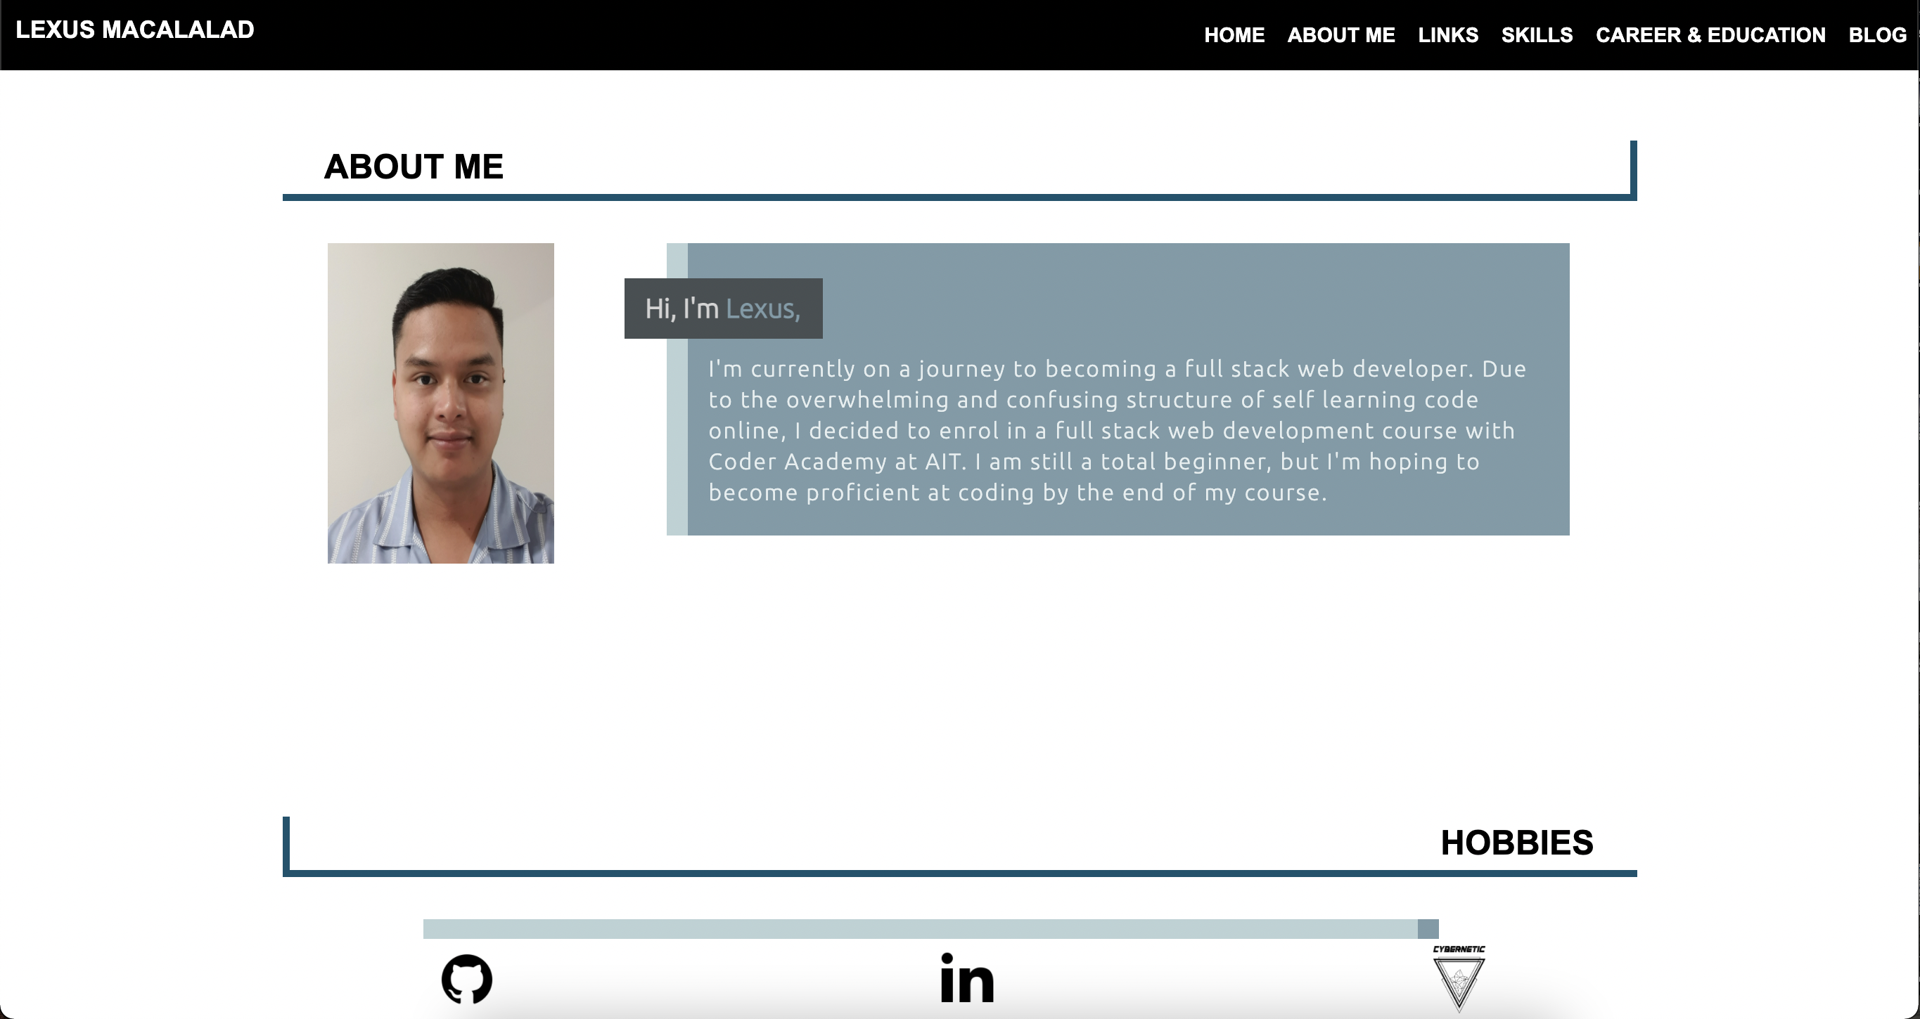
About Me
The about me section allows the audience to know more about who I am as a person

Slide 11
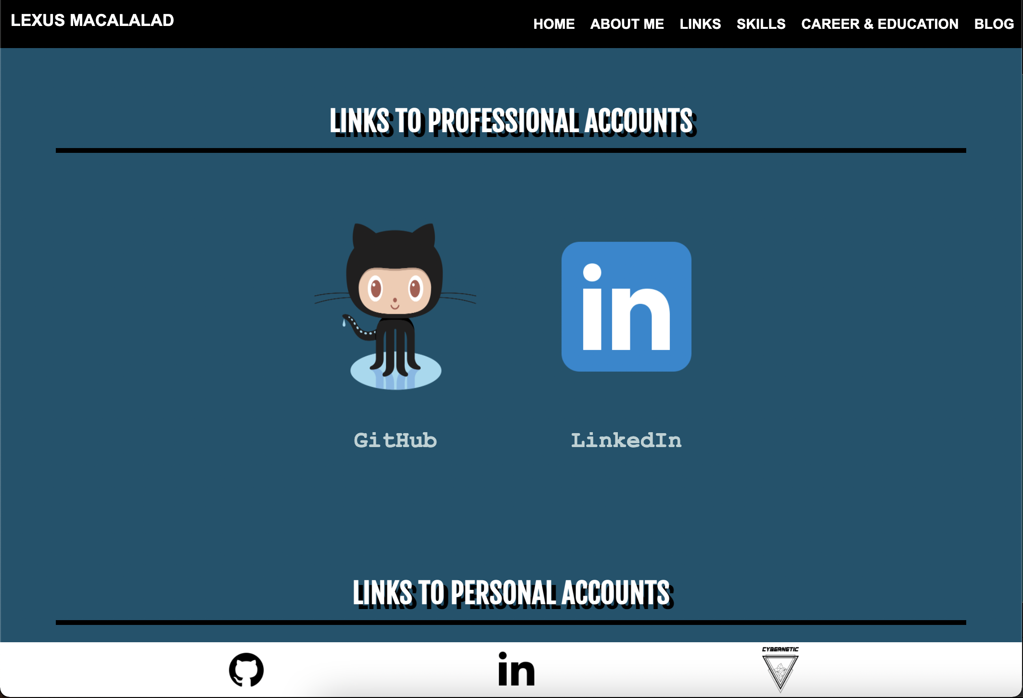
Links
The links section is a good way for the target audience to connect with my other social profiles

Slide 12
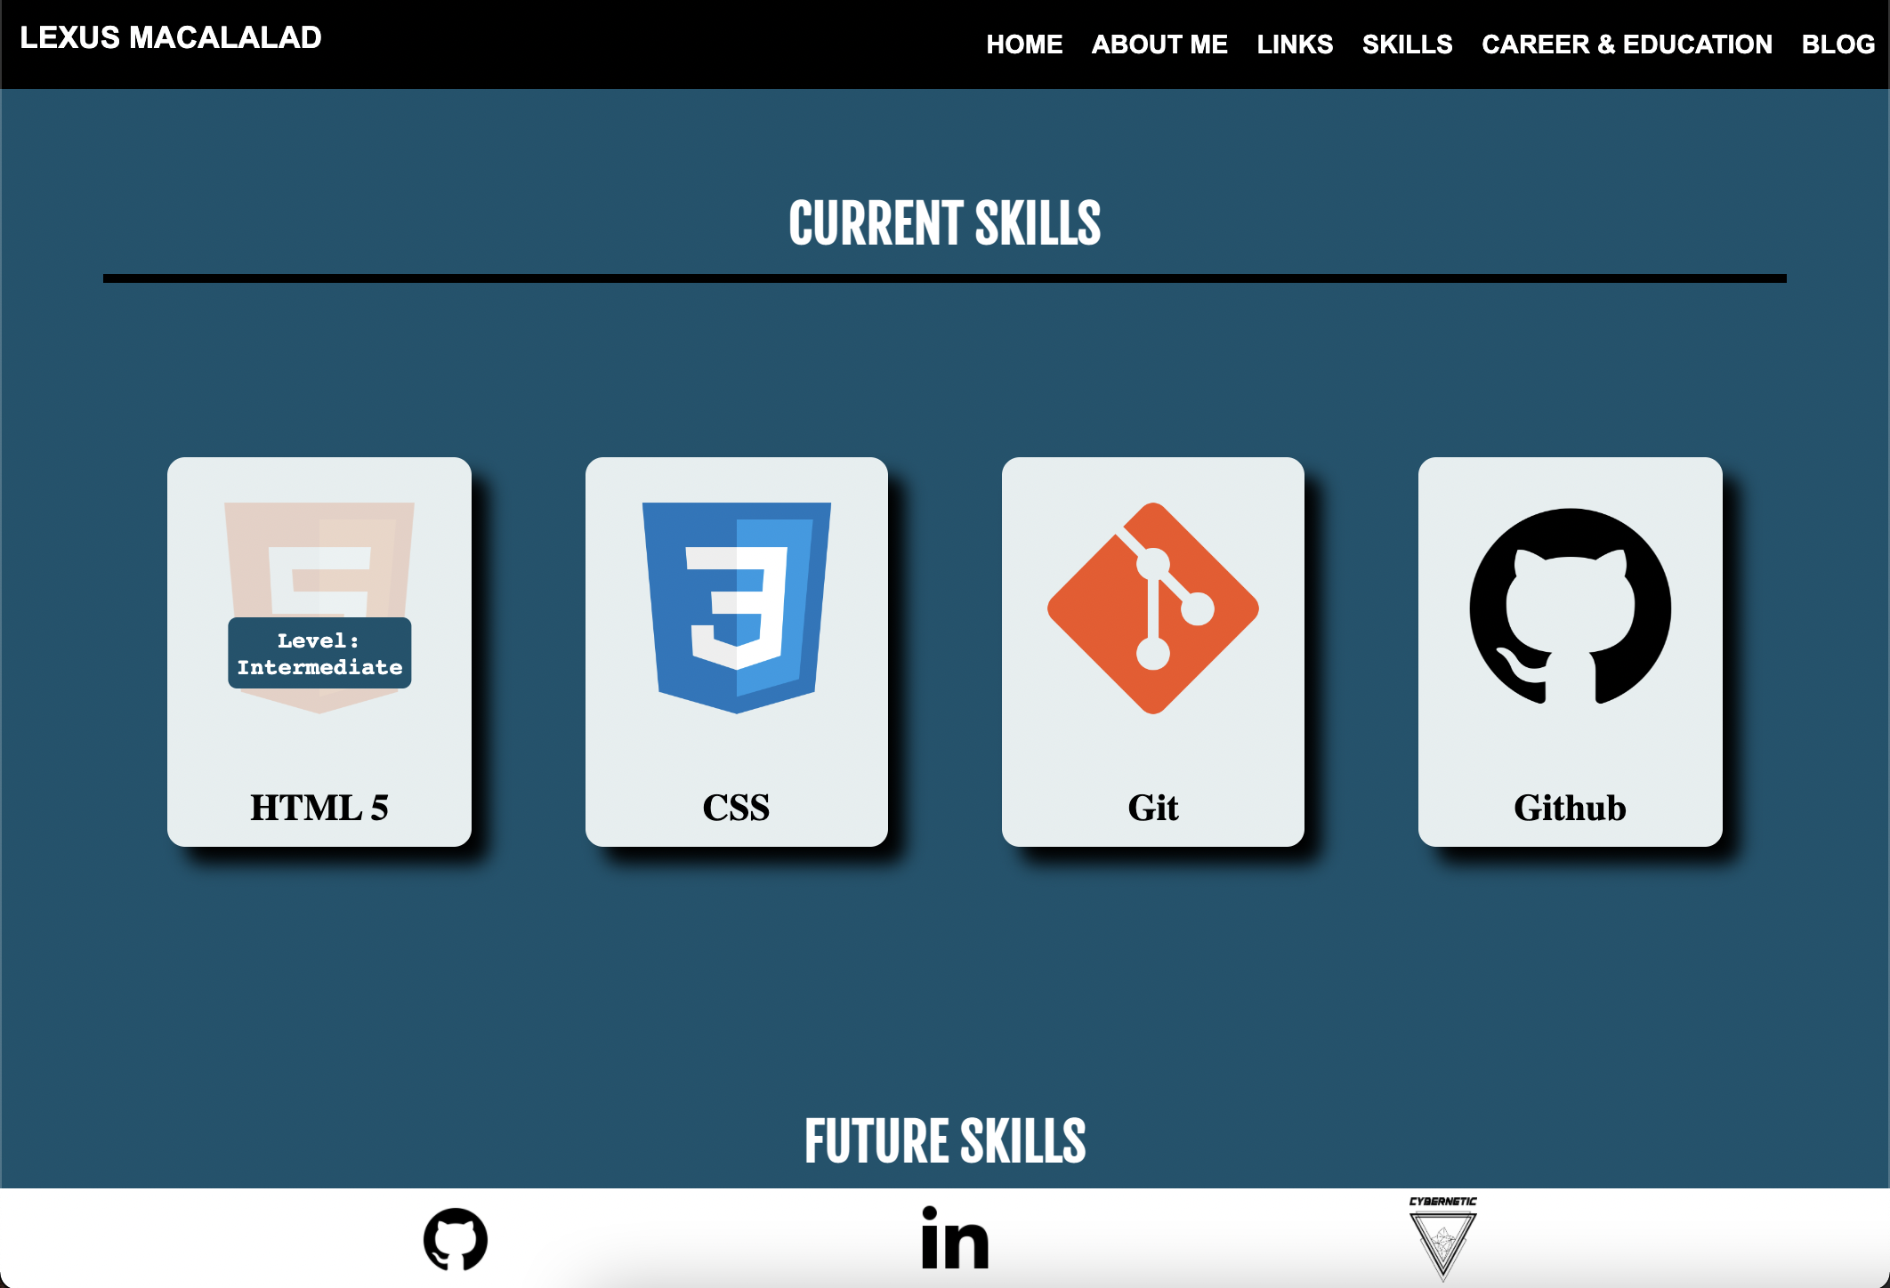
Skills
The audience can gain an understanding of how many languages and what my skill level for each language is by visiting the skills section

Slide 13
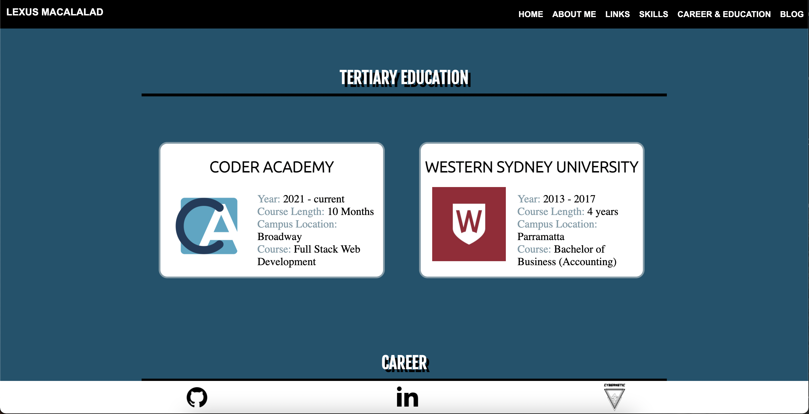
Career & Education
Some recruiters like to look at potential employees career and education history.
I have included my tertiary education as well as my career
The audience can view in more detail what I about my history by including a resume at the bottom of the page

Slide 14
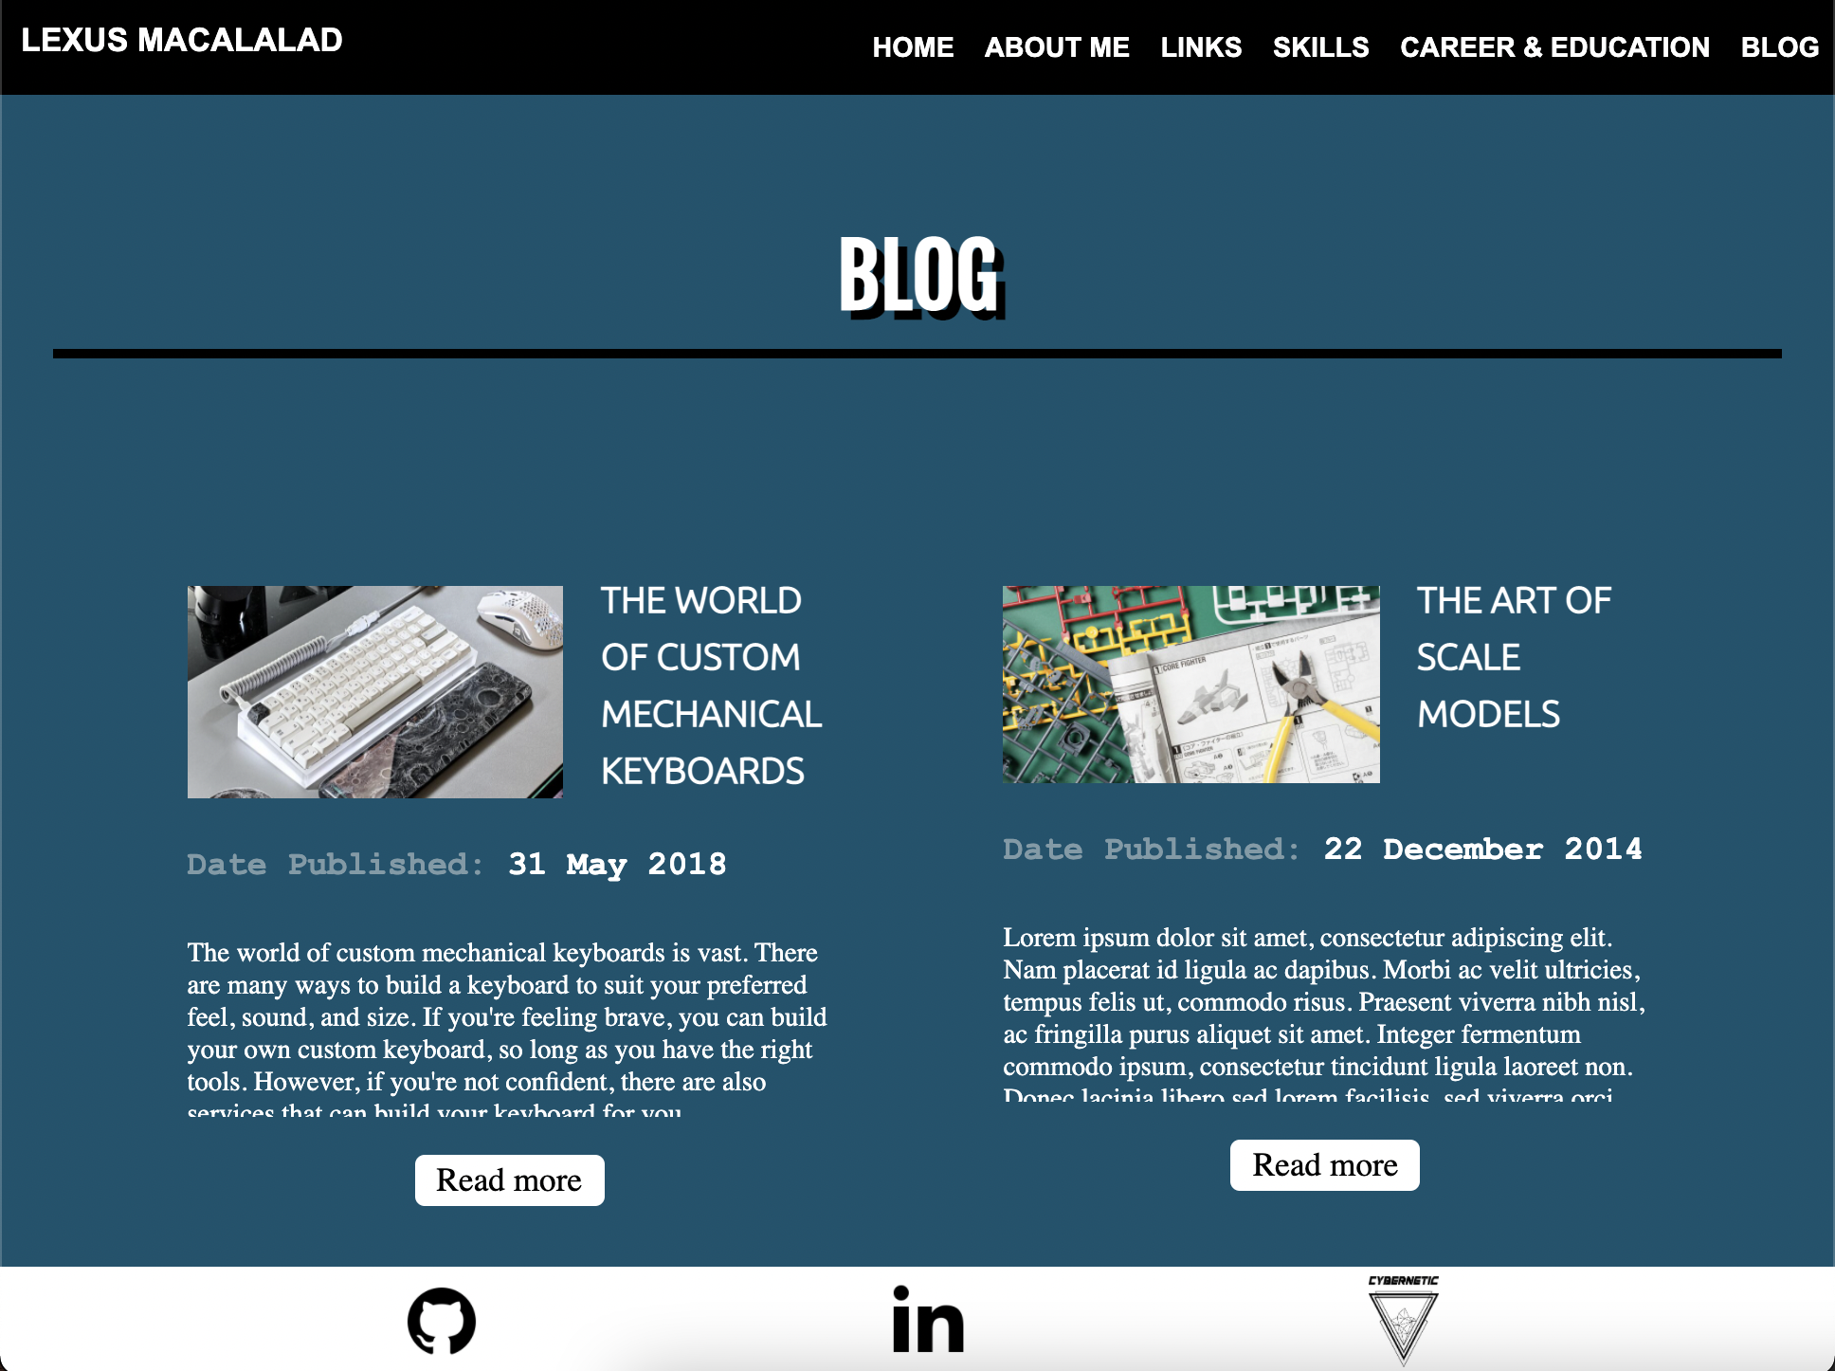
Blog
Lastly, the blog section will briefly introduce my hobbies to the audience, which they can read up more on by clicking on the read more button, which will bring them to an external blog.

Slide 15
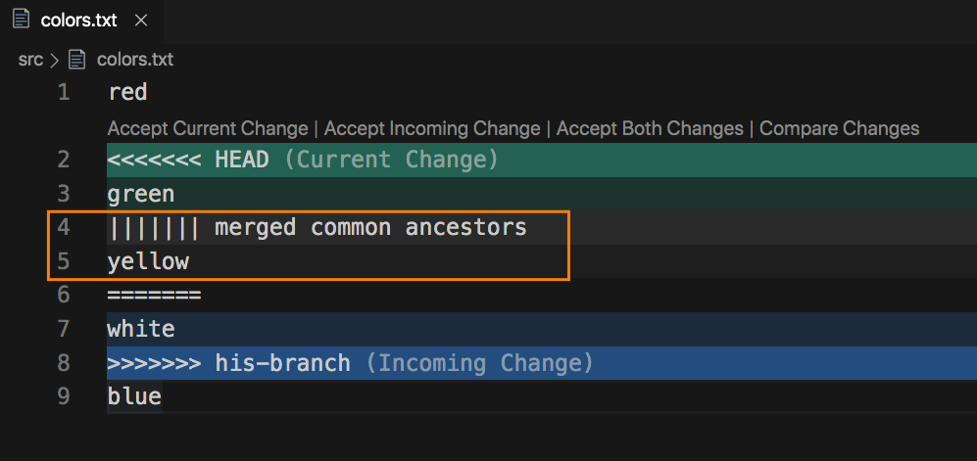
Challenges/Roadblocks
Git Conflicts
Element positioning
Margins
Flexbox

Slide 16

Favourite Parts
Getting the code to work
Learning process
Relationships built with colleagues

Slide 17
Reflections
Skill level
Growth Mindset
Research or review before you start trying new things
Don’t be afraid to ask for help
Portfolio v2

